Slide 1

Canadian Tire ODP
Customer Feedback Analysis:
Automotive Tires & Wheels
May 2023

Slide 2
Automotive Tires & Wheels Medallia Feedback Overview
Search Criteria: Date range: [Jan. 1, 2023 - May 8, 2023], NPS: ‘Likelihood to Recommend (Digital) Score’, Search for words: ‘Tires AND/OR Wheels’.
Dataset: Tracking 175 comments, Updated Medallia Customer Feedback Comments: Dataset
Top Themes and Findings Summary
Product Selection and Availability: Many customers have expressed their frustrations with the inventory and availability of tires.
Navigation and Search: Users are encountering challenges in searching for suitable tires/wheels.
Technical Issues: Users having issues accessing the website, inability to view tires, website loading issues, and malfunctioning shopping carts.
Installation & Maintenance: Frustrations regarding the lack of clarity around installation costs and the difficulty in booking appointments.
Pricing & Description Accuracy: Customers are experiencing inconsistent pricing, inaccurate information on the website, and lack of transparency around additional costs.

Slide 3
Theme Volume Tracker
Total Comments: 175

Slide 4
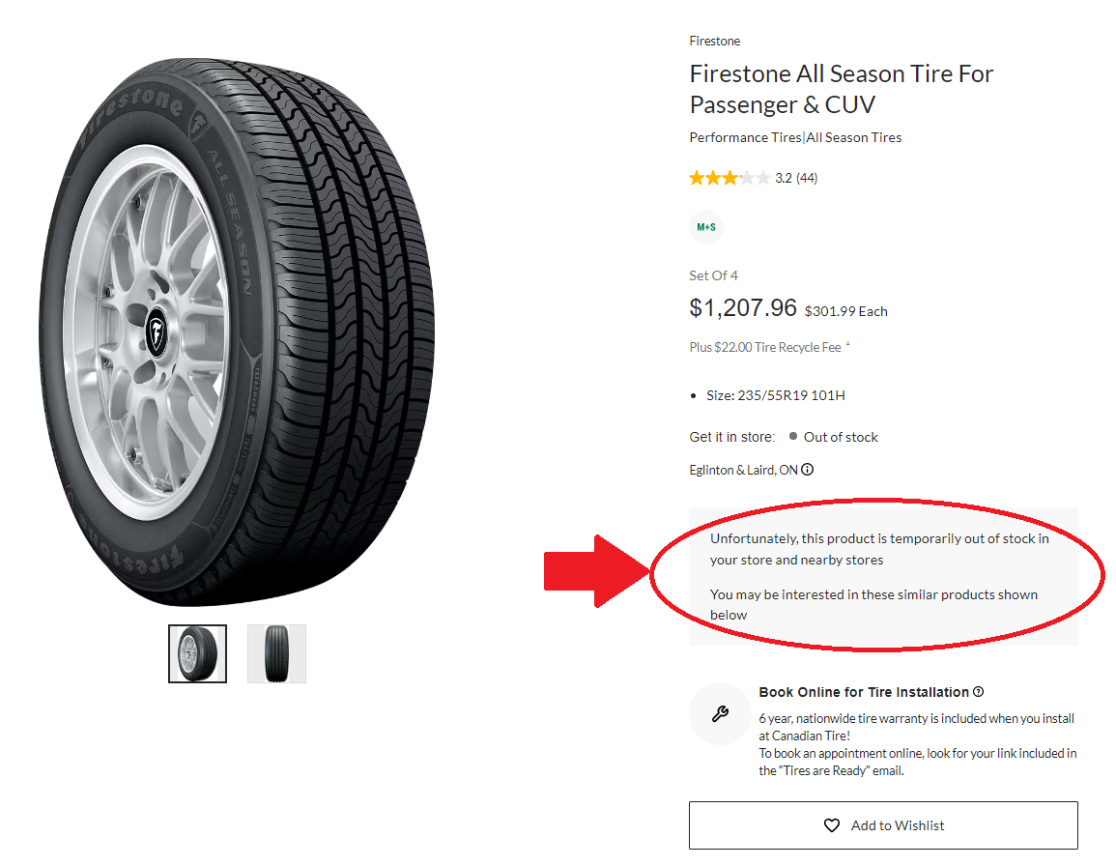

Product Selection and Availability: Many customers have had difficulty finding available tires. Some customers reported that the site shows tires that are not in stock, while others were unable to find tires that matched their specifications.
Customer comments
“Looking for tires and looking for tires you can get are very different. I can see all you offer but most of the time there’s never any inventory.”
“Are there REALLY no tires at all available for a 2012 Chrysler 300C in size 235/55R19 ?”

Slide 5
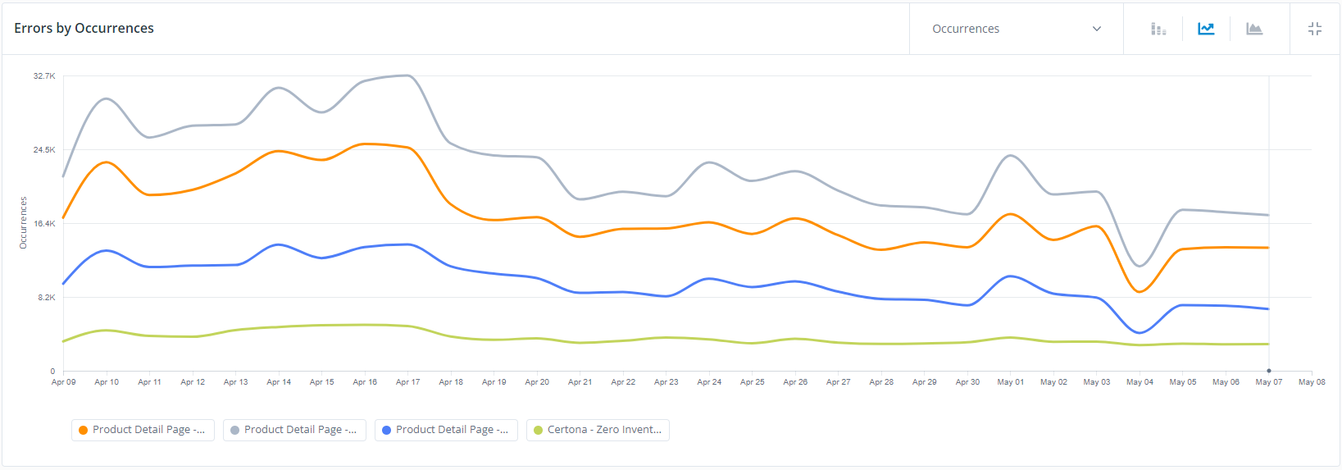
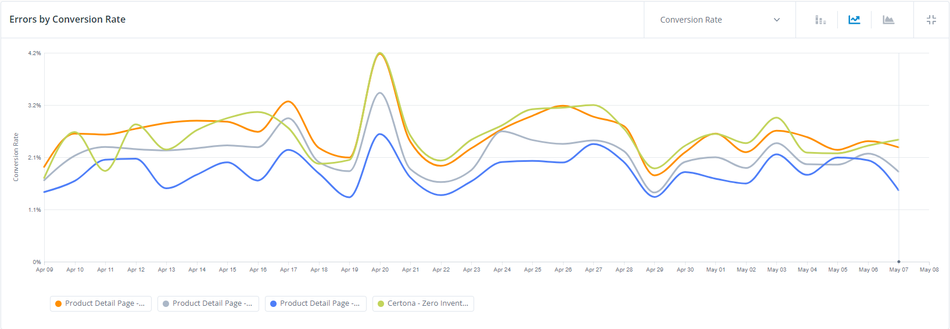
Product Selection and Availability:
QM Viewing Errors
Segment: [Link to Segment]
Date: Last 30 Days, Path > Contains > tires OR wheels AND ‘PDP – Inventory – API’
Key Notes
Although there have been complaints, there has been a noticeable improvement in zero inventory occurrences from April to May.
Conversion Rate remains consistent during high error rates in April
Product Detail Page - Zero Inventory - API
Product Detail Page - Zero Inventory - AL
Completely Out of Stock Modal - 5 Seconds
Certona - Zero Inventory - analyticsLayer

Slide 6
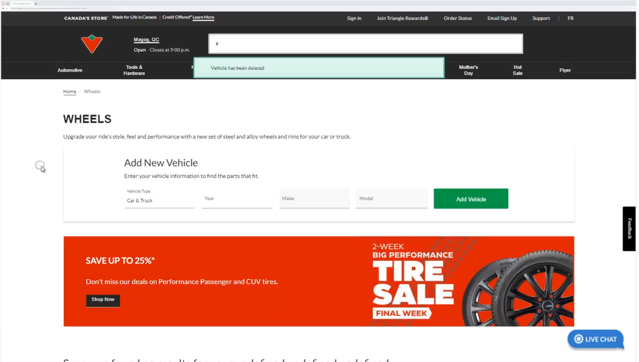
Navigation and Search: Customers have difficulties in exploring available wheels without providing vehicle information, and discrepancies between search results and entered vehicle information.
Customer comments | Notes
“I can't browse your wheels freely without having to mandatorily set a vehicle? That sucks.” | [QM Link] Video shows user attempting to browse wheels without entering vehicle info.
“I want to look at tires by size, but it’s keeps going back to my truck. I have 305 /50r20 tire on my tundra, so I know they fit . Please help me , thankyou I want to buy tires here.”

Slide 7
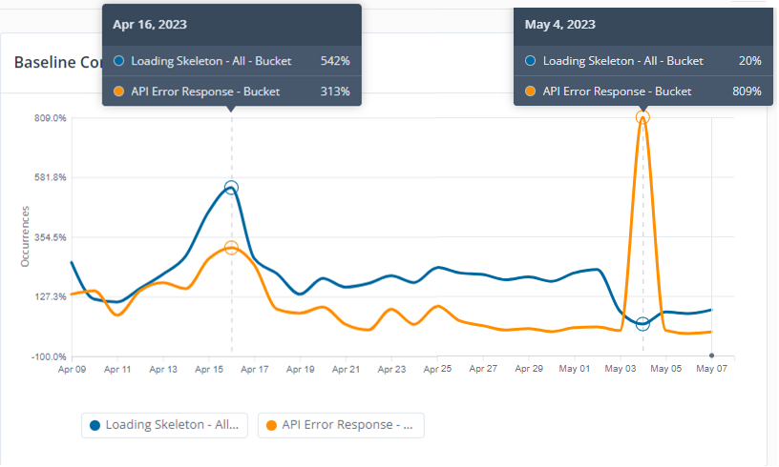
Technical Issues: Quantum Metric Viewing Errors
Segment: [Link to Segment] Date: Last 30 Days, Path > Contains > tires OR wheels
Baseline Comparison by Occurrences
Customer comments
“Tires pages wont load”
“Website given to register a new set of tires not responding”
Key Notes
In early April, there was an increase in user comments addressing technical issues, which was consistent with the trend of technical loading errors that were previously documented.
A massive spike in loading errors occurred on May 05, 2023, but has since been resolved.

Slide 8
Installation & Maintenance: Some customers are confused with the tire purchase and installation process, specifically regarding the lack of clarity around installation costs and the difficulty in booking appointments.
Customer comments | Notes
“It's silly to provide a price for a set of tires without providing a price for installation. I need to compare the full cost of the tires. Tires are useless to most people without installation.” | Customer would like installation package option.
“I want to have my tires installed and you would only let me "pick them up" I find your online purchasing not very straight forward. I wanted to speak with a representative at your store but the automotive shop closes at 5PM. Very inconvenient.” | It would benefit the customers if there was an online scheduling option after hours.
“It could be made more clear how the process works for installation. It sounds like I am expected to pick up the tires but it also says I can book an appointment when I get an email that my tires are ready for pickup. I hope I don’t have to pick the tires up and then drive back to the store later to have them installed.” | The customer seeks to explore the possibility of installing tires on their pickup.

Slide 9
Pricing & Description Accuracy: Customers are experiencing inconsistent pricing, inaccurate information on the website, and a lack of transparency around additional costs.
Customer comments | Notes
“I was showed 2 different prices for same set of tires $67 and 137” | Inconsistence pricing.
“Checked yesterday for pricing of tires. Come back today to purchase them and the same exact tire has increased in price by over $10 per tire. I took a screenshot of the photo from yesterday because this is the second time this has happened. The sale is also not ended.” | lack of transparency around additional costs.
“When I checked for a set of tires, the website indicated they are available at the store. Checking at the store, they told me they do not have them. I keep checking the website and it is still not telling the truth. It is either Canadian Tire are liars or their website is a spam one. Giving false information to customers is bad for business.” | Inaccurate availability online.

